Slide 1
ITC – IWMI Knowledge Partnership
Drought Proofing

Slide 2
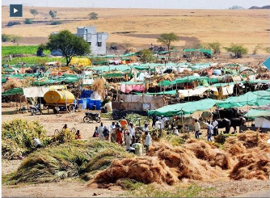
Drought: A Serious Water Related Risk
Monsoon dependent Indian agriculture suffers from recurring droughts
Droughts and floods are the two extremes of hydrology
Occurs in all agro-climatic regions, but has more severe impacts in arid and semi-arid regions and rainfed areas
A creeping type disaster that accumulates slowly and severely impacts agriculture, economy and society
Drought affects are more pronounced and long lasting
Increasing incidence and severity of droughts due to climate change
Flood frequented areas now witnessing drought and vice-versa

Slide 3
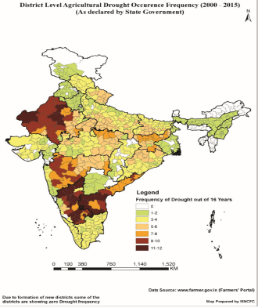
Increased Incidence & Severity of Droughts
Rainfall departure from normal-India
Dry reservoir/tank beds
Year | RF Deficit (Production loss) (%)
2002 | -19 (-15.40)
2009 | -23 (-4.12)
2014 | -12 (-3.25)
2015 | -14 (-2.35)
Dry wells
Increased frequency in last decade
% storage (MMI reservoirs) in 2009 compare to last 10 years average

Slide 4
Understanding the Drought
Precipitation deficiency
High Temperature, Winds, Sunshine
Economic Impacts
Increase in food prices
Loss to dairy, livestock
Damage to fish habitat
Loss of hydro power
Meteorological
Drought
A significant deficiency in rainfall leads to drought
Drying of water bodies
Reduced stream flow
Depleting groundwater
A normal, recurring climate phenomenon varying in space-time-intensity
Hydrological drought
Social Impacts
Food deficit, suicides
Water user conflicts
Political conflicts
Increased poverty
Soil water deficiency
Increased ET
Plant Water Stress
Agricultural drought
Environ. Impacts
Desertification
Severity of fires
Damage to plants
Diseases
A ‘Creeping’ disaster, largely localised
Reduced supply of economic goods due to weather variability/ water scarcity
Socioeconomic Drought

Slide 5
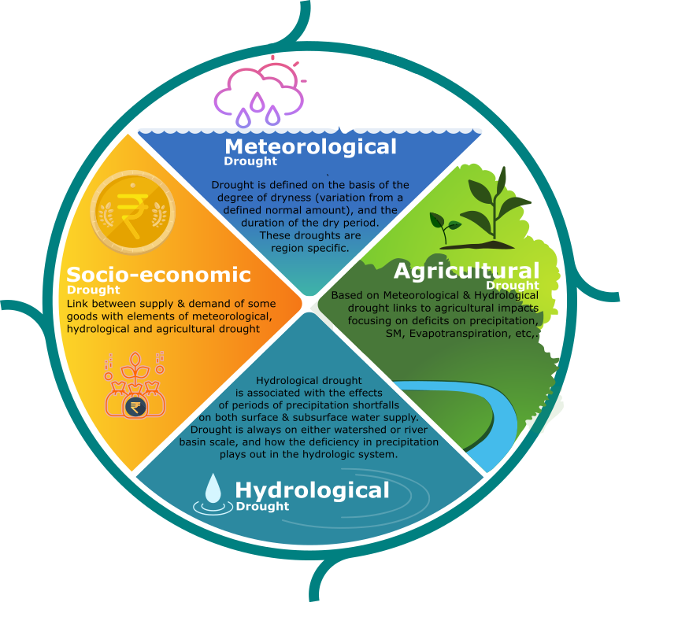

Drought types
Natural Climate Variability
Precipitation Deficiency
(amount, intensity, timing)
High temperature, high winds, low relative humidity, greater sunshine, less cloud cover
Meterological Drought
Reduced infiltration, runoff, deep percolation and ground water recharge
Increased evaporation and transpiration
Agricultural Drought
Soil Water Deficiency
Plant Water Stress, reduced biomass and yield
Hydrological Drought
Reduced streamflow, inflow to reservoirs, lakes and ponds; Reduced wetlands,
Wildlife habitat
Socio-Economic Drought
Economic Impacts
Social Impacts
(Source: NDMC)

Slide 6
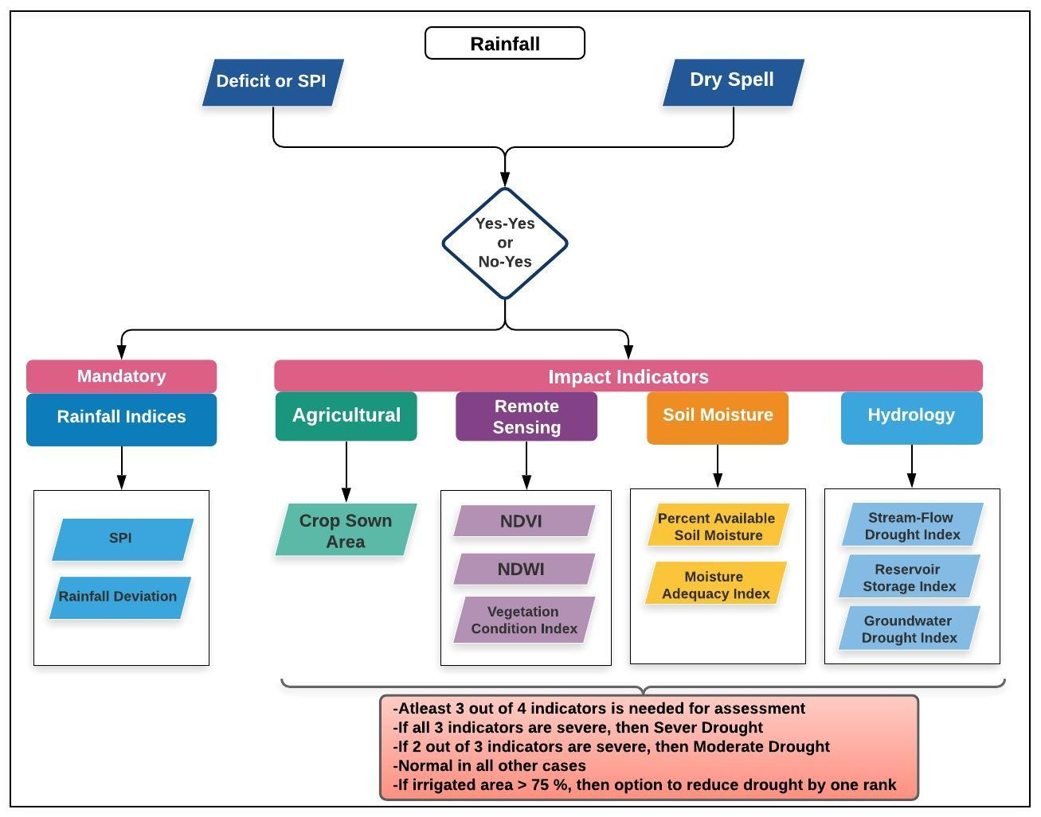
Drought assessment, indicators and declaration Manual for Drought Management, India (2016)
Meteorological (rainfall)
Deficiency
Delay
Dry spells
Hydrological
Storage reservoir, tanks
Streamflow
Groundwater level
Agricultural
Sowing delay
Sown area
Crop health
Soil moisture
Cropping pattern

Slide 7
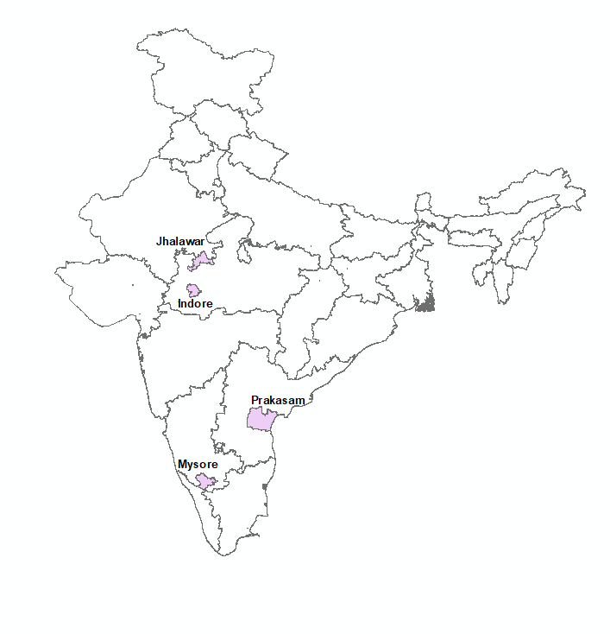
Drought proofing ITC Agri-Catchments
Defining drought proofing, since no consistent definition exists;
Classification of drought vulnerability and a methodology to apply for classification.
Developing framework and indicators for assessing drought proofing;
Defining interventions required to achieve drought proofing and assessing ongoing activities in terms of their drought-proofing ability
STABILISING CROP PRODUCTION: All crops in watershed
WATER AS A RESOURCE: Technical assessment
FRAMEWORK: Simple and robust and location agnostic

Slide 8
Defining Drought Proofing ITC Agri-Catchments
Drought proofing: Ensuring the capacity to meet the basic material and physical needs of the local population (both human and animal) during a drought period so that there is minimal distress
Specifically, in the context of project and of ITC’s agri- catchments
Drought proofing is defined as preparing catchments to face drought with the minimum possible adverse effects by efficient and effective use of water resources with the objective of stabilizing crop production
Outcome of stabilizing crop production: enhanced farmers’ drought resilience at micro level and stabilizing farm incomes.
Aim is not to recommend or go for crop changes but on how water and land management can drought proof and to what extent the existing cropping pattern.
In terms of water management interventions, special focus to nature based solutions (NBSs), catchment area management for water, soil moisture management, sub-surface flow improvement as part of the natural resources management and watershed works.

Slide 9
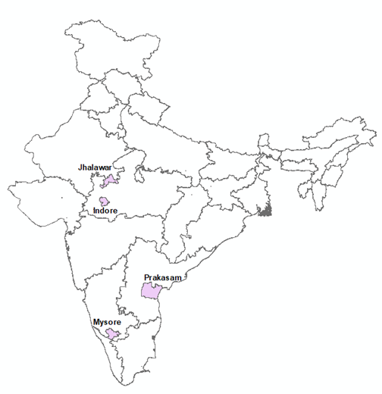
Drought Proofing Agri-Catchments
Drought proofing is a continuous process
Drought proofing spans over both normal, drought and surplus years
Real preparedness to drought proofing should actually happen during the non-drought years by harvesting and storing water and judiciously using water
During drought years with scanty rainfall, it’s preparedness and carryover storage with efficient water management that helps.
On a long term basis, there are essentially two water related drought proofing meaures
Harness water through water harvesting/conservation, spread of irrigation, groundwater recharge & watershed development
Promote demand management measures including water use efficiency and water productivity improvement, drought tolerant and short duration crop varieties

Slide 10
Assessing Drought Proofing: Methodology
Design principle: Scientifically robust but simple to be applied on field by ITC staff with minimum training
Drought risk assessment
Rainfall deficit: Frequency, Severity and Timing
Framework and indicators
Indicators
Application
Apply to Agri-catchments
Suggest and assess interventions
What and how to measure
Hydrology drought
Conceptual framework
Water balance tool

Slide 11
Drought Risk assessment
Drought is characterized by the intensity, duration and timing.
Drought index used to assess drought risk.
A drought index is a standardized numerical value based on anomalies of a selected parameter (e.g. precipitation, soil moisture) when compared with its long-term mean
Part of groundwater drought manual
Standard Precipitation Index (SPI): Widely used rainfall index
SPI assigns a single numeric value to precipitation, which can be compared across regions and time scales with markedly different climates.
Only rainfall data is need which is the primary causative factor of drought and easy to calculate
Drought initiation and termination are implicit part of the index
Can be calculated for different time steps (1, 3, 6 and 12 months) with shorter time periods for agricultural and meteorological drought the longer seasons for hydrological drought
With SPI, drought intensity, magnitude, and duration can be determined, as well as the frequency of drought.

Slide 12
SPI
Values of SPI are expressed in standard deviations, positive SPI indicating greater than median precipitation and negative values indicating less than median precipitation.
Use of SPI
To know when and how frequently the drought occurs
Longer SPI (3 or 4 months): For entire crop duration
Shorter SPI ( 1 month): Intra season variation
Planning and designing interventions to mitigate seasonal and intra-seasonal drought
For each season and month, % of years under different drought categories are calculated.
SPI values | Drought category
0 to -0.99 | Mild drought
-1.00 to -1.49 | Moderate drought
-1.50 to -1.99 | Severe drought
< -2.0 | Extreme drought

Slide 13
Example: SPI: 1 month
 | Moderate drought | Mild drought | Severe drought | Extreme drought
Jan | 68.4% | 28.9% | 0.0% | 0.0%
Feb | 68.4% | 31.6% | 0.0% | 0.0%
Mar | 26.3% | 65.8% | 0.0% | 0.0%
Apr | 0.0% | 50.0% | 0.0% | 0.0%
May | 0.0% | 13.2% | 0.0% | 0.0%
Jun | 0.0% | 42.1% | 0.0% | 0.0%
Jul | 0.0% | 39.5% | 0.0% | 0.0%
Aug | 0.0% | 36.8% | 0.0% | 0.0%
Sep | 0.0% | 21.1% | 0.0% | 0.0%
Oct | 0.0% | 5.3% | 0.0% | 0.0%
Nov | 2.6% | 60.5% | 0.0% | 0.0%
Dec | 31.6% | 65.8% | 0.0% | 0.0%
No monthly severe and extreme drought in area
Mild drought occurs the most followed by Moderate with high frequency in low rainfall months of Nov-Mar.
In Main rainfall season of May-October, drought is limited
However, Jun-August shows high frequency of mild droughts.

Slide 14
Example SPI: 3 month
 | May-July | Jun-Aug | Aug-Oct
Mild drought | 34.2% | 52. 6% | 18.4%
Moderate drought | 0.0% | 0.0% | 0.0%
Severe drought | 0.0% | 0.0% | 0.0%
Extreme drought | 0.0% | 0.0% | 0.0%
Seasonally, there is occurrence of only mild drought
For May-July, ~ 1/3 years witness mild drought
For Jun-Aug, ~ 1/2 years witness mild drought
For Aug-Oct, ~ 1/5 years witness mild drought
Need for water supply augmentation for low rainfall months in rainfall season i.e. in Jun-July-Aug to support water requirement of crops sown in May
In low rainfall months of Nov-Mar, no crop without irrigation is possible
Reduce runoff and increase in recharge and soil moisture in high rainfall months

Slide 15
Hydrological drought
Hydrological drought index is proposed as a measure, especially in areas where storage in either surface reservoirs or groundwater is the primary source of irrigation, to give early indication of drought and help in preparedness and drought mitigation.
For this, groundwater table/carry over reservoir storage before the start of rainy season is analyzed to indicate how prepared an area is in terms of storage if drought occurs, as identified above.
Hydrological drought index is encapsulated in the index:
Standardized Water Level Index (SWI) for groundwater
Standardized Reservoir Supply Index (SRSI) for surface reservoir
Similar to SPI and is calculated by taking the difference of the storage (reservoir or groundwater levels) from the mean for a particular time step, and then dividing it by the standard deviation
For this, groundwater table data or reservoir storage data for at least last 10 years is to be considered

Slide 16
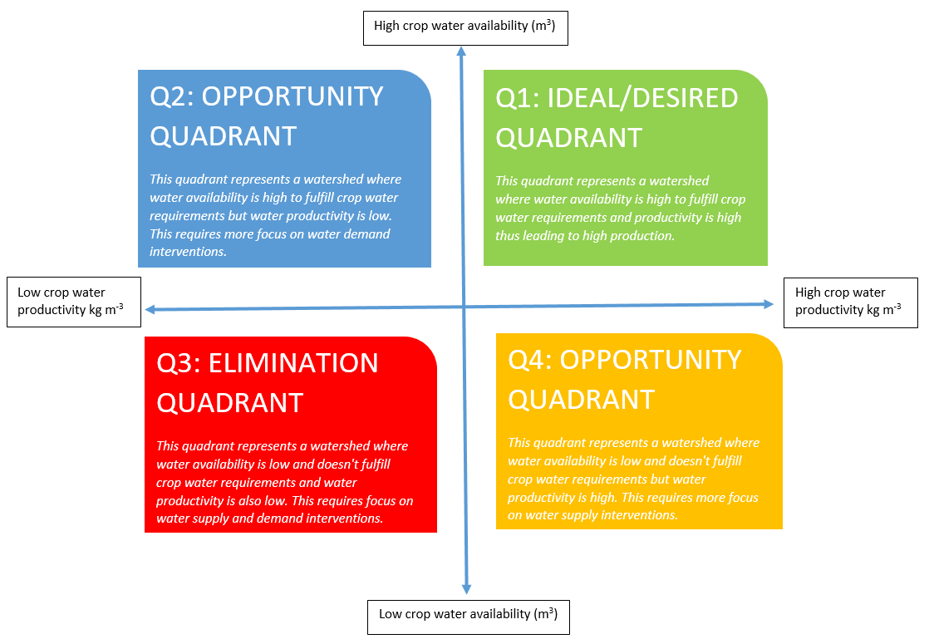
Drought proofing framework
Drought proofing framework is developed for conceptualizing drought proofing and accordingly design the interventions to alleviate the crop from future droughts and is focused on stabilization in crop production.
Conceptualize ‘drought proofing’ as an interaction between water availability for crop and water productivity
Indicates where a crop lies and what interventions (and to what intensity) are required.
With intra and inter-year variability, need to ascertain this for different seasons and different years
e.g. in normal year, crop might lie in quadrant 1 but in drought year in quadrant 4 thus need for building water supply augmentation
Efficiency/Demand management interventions
Supply augmentation interventions

Slide 17
High water availability
Desired situation: High WA and high WP
Good year but low WP
Improve Water Use Efficiency
Mod
I
F
I
E
D
Demand/efficiency improvement interventions required
Crop 1 in drought year after interventions
LOW Water Productivity (kg/m³)
HIGH Water Productivity (kg/m³)
Improve Water availability and Use Efficiency
Improve water availability
Both supply and demand/efficiency intervention required
Crop 1 in drought year
supply side intervention required
Drought: Low WA and LOW WP
Drought: Low WA and high WP
Low Water availability

Slide 18
Drought proofing indicators
Increase in Water availability
Decrease in unmet CWR
Increase in yield and production
Increase in Water use efficiency
Assuming all other non-water management interventions are in place
Taking attainable yield: average yield in normal years with no deficit
Increase in WA through rainfall capture in soil moisture, ponds/surface storages and GW recharge (reduction in run-off) and reducing non-beneficial evaporation from fallow areas.
Increase in water application efficiency in irrigated agriculture

Slide 19
When is watershed drought proofed
The extent of sowing is an important indicator of the spread and severity of drought
Drought conditions could be said to exist if the total sown area under kharif crops was less than 33.3% of the total normal sown area by the end of July/August
However, the conditions will indicate portents ??? for drought of a ‘severe’ nature will appear strong, if the area under crops falls to 50% of the normal by the end of July / August
In the case of Rabi crops, coverage of sowing of less than 50% of the total normal sown area during October-November is a strong indicator of a drought like development
Late drought
Early drought
Extreme drought vs severe drought
If drought proofing is to be considered and investigated, comparison should be between years of similar rainfall patter both in extent as well as distribution.
Definition: Loss less than 20 % or 30 %
Sensitivity of output to rainfall is estimated…: drought proofing should lead to less sensivirtty

Slide 20
Managing Drought: Crisis Management to Risk Management
Traditional approach to drought management is reactive and addresses crisis management after drought takes place
It’s ad-hoc, often expensive and response is poorly coordinated and targeted
Increased realization to shift from crisis management to Risk Management through medium and long term drought proofing measures as a preparedness strategy
Pro-active measure with advance planning to improve operational capabilities (climate and water supply monitoring, building resilience and institutional capacity), preparedness and mitigation to reduce future impacts.
Drought Management Plans consisting of monitoring and early warning, long and medium term mitigation and response measures including supply augmentation and demand management to lessen the need for ad-hoc interventions.

Slide 21
Medium and Long Term Strategy
-Supply Augmentation Measures
Investments in water harvesting and water storages including watershed management
Networking of reservoirs, lakes, rivers, other water bodies,
Enhanced ground water recharge,
Ground water banking during non-drought years,
Improved water conveyance and piped distribution
Conjunctive use of rain, canal and ground water
Long Term: Demand management Measures
Efficient water application including micro irrigation
Economic incentives for water saving
Increasing water productivity
Water budget based crop and water use planning
Drought tolerant and water efficient cultivars
Crop diversification to minimize water use
Conservation agriculture, land levelling, mulching

Slide 22
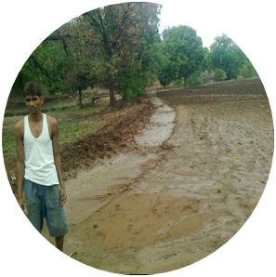
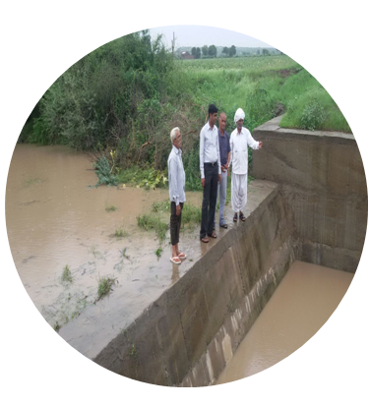
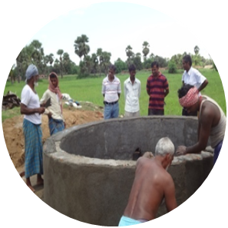
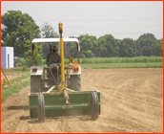
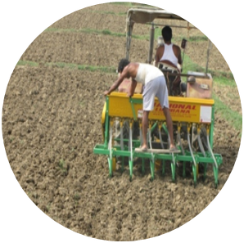
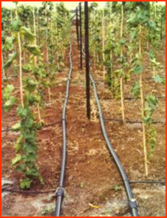
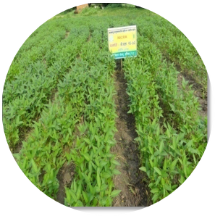
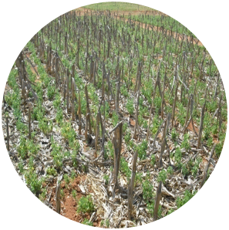
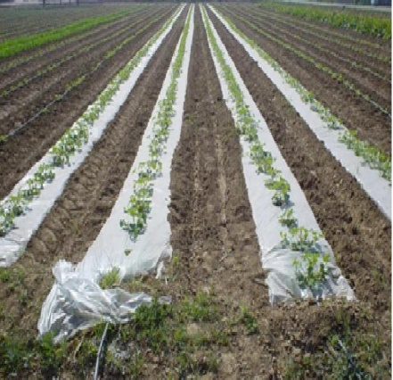
Smart Drought Management Interventions
Building resilience by enhancing storage (in situ, surface and groundwater)
Improving irrigation efficiency and water productivity
Laser land leveling, zero-tillage & conservation agriculture, BBF
Conjunctive use of good and poor quality GW / wastewater
Drought tolerant crop varieties
Crop diversification
Integrated farming systems
DSR
BBF
CA

Slide 23
Operationalizing: Water Balance tool
Water balance tool helps in site specific water balance, crop yield and crop requirement assessments
Dynamically links them with water management interventions to assess impact of drought on crop production and how much interventions can mitigate the negative impacts
The tool applies monthly water budget approach in balancing the water resources availability and water demand within the study area.
Suitable for homogenous agri-catchments with crop area as dominant land use
The tool is modelled in excel spread sheet with minimum input data requirements for simplifications.
Drought proofing Indices can be derived from the results
The two-key function of the tool are
To assess the water balance of the study area for various hydrological conditions (dry, normal & wet year)
To assess the impact of proposed land and water interventions

Slide 24

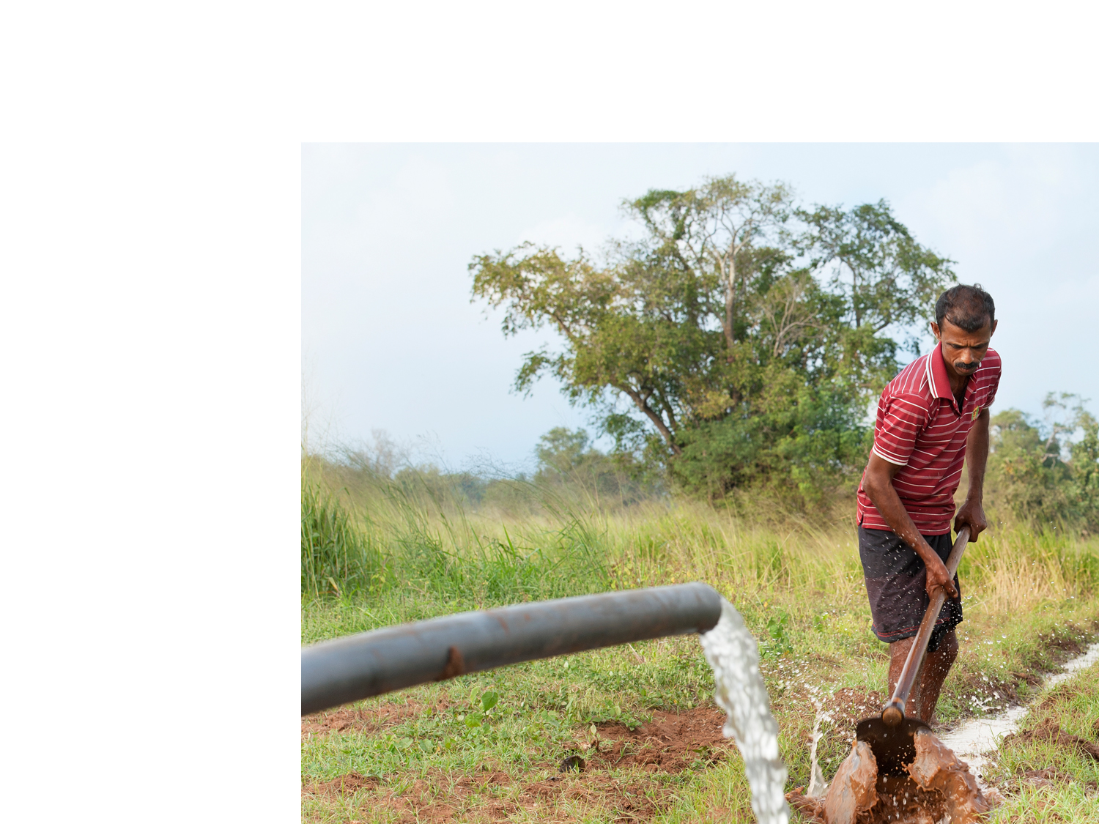







Step 1: Input Parameters
Land Use & Soil
Soil Types, depth & Distribution
Hydrological condition
Land Use Land Cover Data
Latitude & Hemisphere
Rainfall & Temperature
Daily Rainfall data
Monthly Min & Max temperature
Data for Normal rainfall, Moderate drought & extreme drought year.
Crop Pattern
Crop Type and growth duration
Provision for 6 crops
Rainfed & Irrigated area
Sowing Month & Week
Irrigation & Domestic
Irrigation Efficiency
Groundwater & Surface water dependency (%)
River / Canal water availability
Population & daily water usage
Inbuilt Parameters: Infiltration rate, Field capacity, Wilting depth) and Crop pattern section (Crops, Crop growth duration days, Crop coefficient, yield response factor, root depth, crop yield, price, depletion factor).

Slide 25



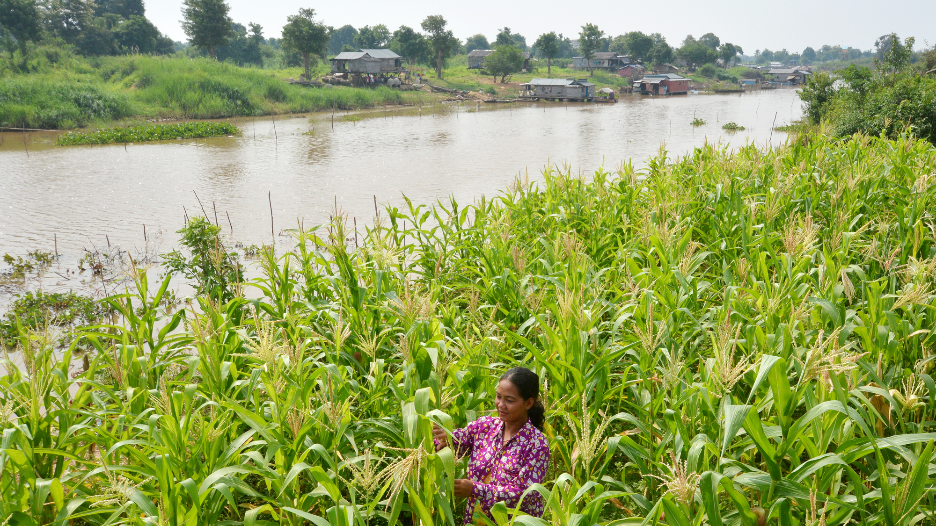

Step 2: Defining Scenarios & Interventions
Supply Side Interventions
To Augment Water Storage
Increase Groundwater Storage
Interventions
Demand Side Interventions
Increase irrigation efficiency
Save Water
Economics
Evaluation Period
Interest rate
Scenarios
Simulating Water Balance for :-
Normal Rainfall Year
Moderate Drought year
Extreme Drought year
To begin with, water balance is simulated for normal rainfall year without any scenarios to set benchmark (baseline Scenario)
Soil Moisture Interventions
Reduce Runoff & Soil Evaporation
Increase moisture holding capacity of Soil
The efficiency and impact of each intervention is Pre-defined in the tool with option to modify based on site conditions

Slide 26
Step 3: Output Parameters
Output | Description
Water Balance Results Water Productivity Crop Yield, CWR & Production Economic Analysis | Water Balance Results Rainfall, Runoff, Recharge & Evaporation Annual & Monthly results Results for each scenario | Water Productivity Provides details on yield per unit of water applied (Kg/cu.m) Rainfed & Irrigated Crop Water productivity Overall results & Cropwise results | Crop Yield, CWR & Production Crop Water Requirement & Irrigated Water Requirement Rainfed Crop yield & Rainfed CWR met (in %) Irrigated Crop yield & Irrigated CWR met (in %) Overall Crop Yield (%), Production (tonnes) & CWR met (%) | Economic Analysis Total cost of all interventions Monetary Benefits Benefit-Cost Ration (BCR)

Slide 27
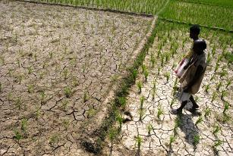
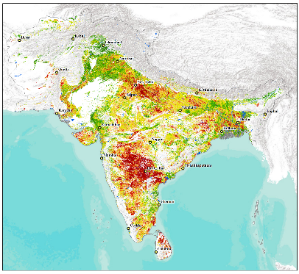


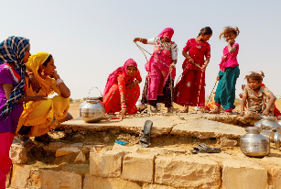

South Asia Drought Early Warning System (SADEWS)
Agriculture Drought Monitor for South Asia
The drought outlook for Kharif 2017 is part of the ICAR–IWMI collaborative research project on “Drought Monitoring, Planning and Management: Improving Food Security and Resilience of the drought affected states in India”
Drought bulletin for 2017 Kharif jointly prepared by IWMI-ICAR/CRIDA for India and specific States like Andhra Pradesh, Karnataka to monitor the agriculture drought situation
Issue No. 1: 17th June 2017

Slide 28
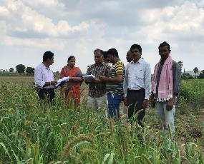
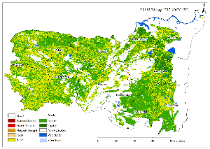
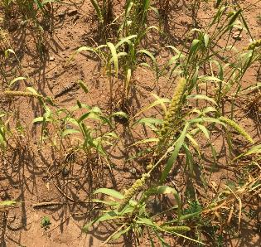
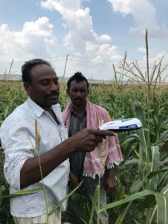


Real Time Drought Contingency Planning
Site locations:
Anatapur; Kurnool
Amaravti ; Aurangabad
Khammam;Ranga Reddy
Joint field validation (CRIDA-IWMI-KVK) of IDSI drought product in Kurnool district, in September 2017;
Field measurement using Crop Sensor to validate vegetation stress (NDVI) and brief to farmers
Drought contingency plans discussed for land use and crops options
Vegetation Health Monitor
Crop Sensor measuring vegetation index
Stress condition of Foxtail Millet

Slide 29
Thank You

Slide 30
Drought
A temporary aberration but is a normal, recurring feature of climate unlike aridity or even seasonal aridity (in terms of a well defined dry season), which is a permanent feature of climate.
leads to a situation where the supply of water is insufficient to meet the needs of people and the environment.
Drought condition primarily originate on account of substantial rainfall deviation [quantity, distribution: spatial and temporal] from the normal
characterized by variability in terms of its spatial expanse, intensity and duration
Agriculture is most vulnerable absorbing up to 80% of drought impacts, affecting agricultural production, food security and rural livelihoods
Spread and intensity of the intensity depends on several factors:
status of surface and ground water resources
agro-climatic features
cropping choices and patterns
socio-economic vulnerabilities of the local population etc.

